Slide 1

Git and Github
A Distributed Version Controlled

Slide 2
Overview of Git
What is Git ? Installation and Setup
Introduction to Version Control and workflow of Git
Understanding of Git init, status, add, commit, push
Branching, Merging and Rebasing
Working with upstream, remote with Github and CodeCommit

Slide 3

What is Git ?
A distributed version control system
Everyone can act as the server
Everyone mirrors the entire repository instead of simply checking out the latest version of the code.
Cheap to create new branch, merge, etc
Git and GitHub are different. Git is a software and Github is a service

Slide 4
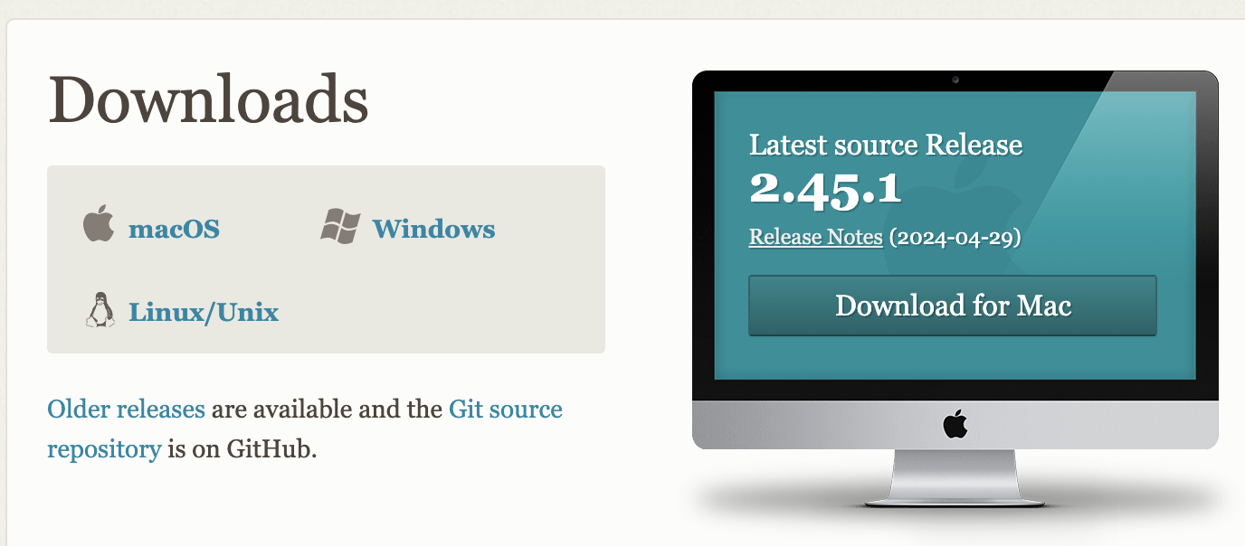
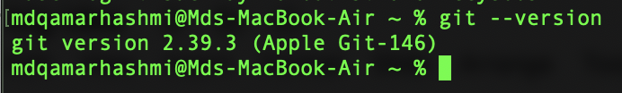
Installation of Git Tool
https://git-scm.com/downloads
Post installation check your git version using command “git --version”

Slide 5
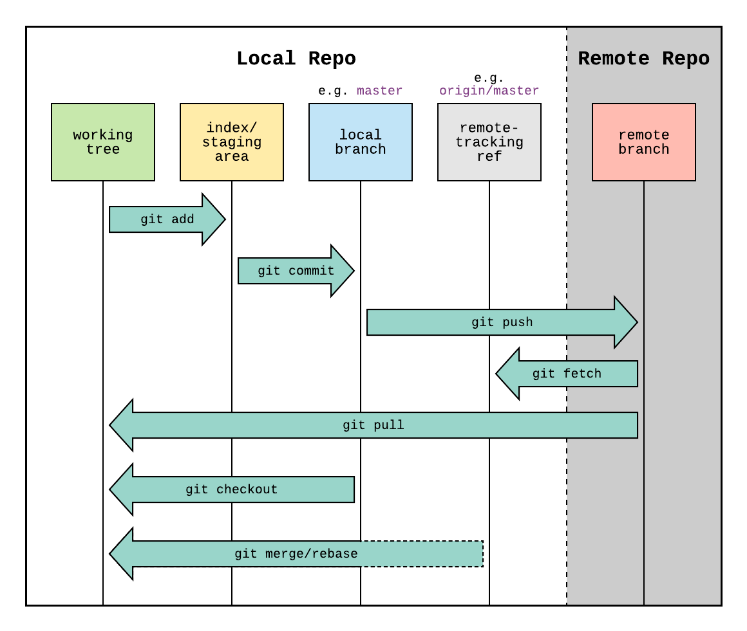
Basic Workflow

Slide 6
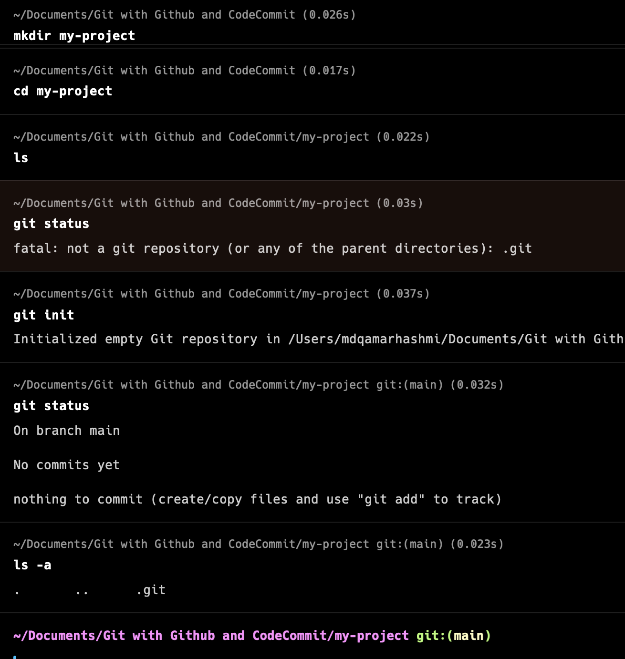
git “status” and “init”
Command : git status
Shows current branch information. In my it shows “main”
What changes to be committed
Changes that are staged for commit
Shows branch tracking information and etc
Command : git init
Initializes a new Git repository in the current directory or in the specified directory.
Creates a “.git” directory: This directory contains all the necessary Git metadata and configuration for the repository(like object database, configuration files, and the index.)
No remote tracking
Initialized only once per project.
Undoing initialization : Remove .git folder. However, be cautious, as this action permanently removes all version control history and configuration.

Slide 7
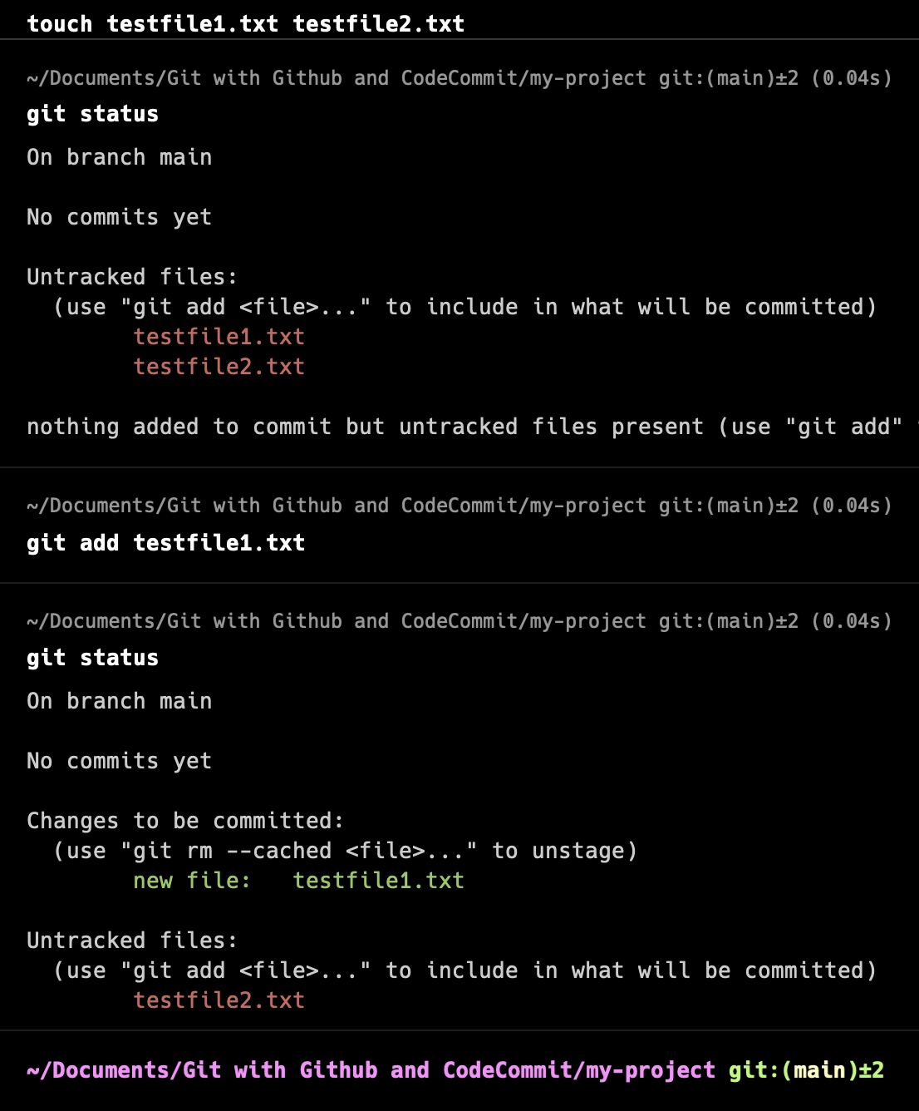
git “add”
Command : git add <filename>
Add files to be committed with “git add <filename>” or “git add .” Puts the file in the “staging area”
Let’s create two files named “testfile1.txt” and “testfile2.txt”.
Run “git status” to check the status and it will show two untracked files.
Run “git add testfile1.txt” and perform “git status” to check the status.
Status would show “testfile1.txt” as tracked and ready to commit. However, “testfile2.txt” shows as untracked.
Just in case if you want to make any file as untracked run below command
Command : git rm --cached <file-name>

Slide 8
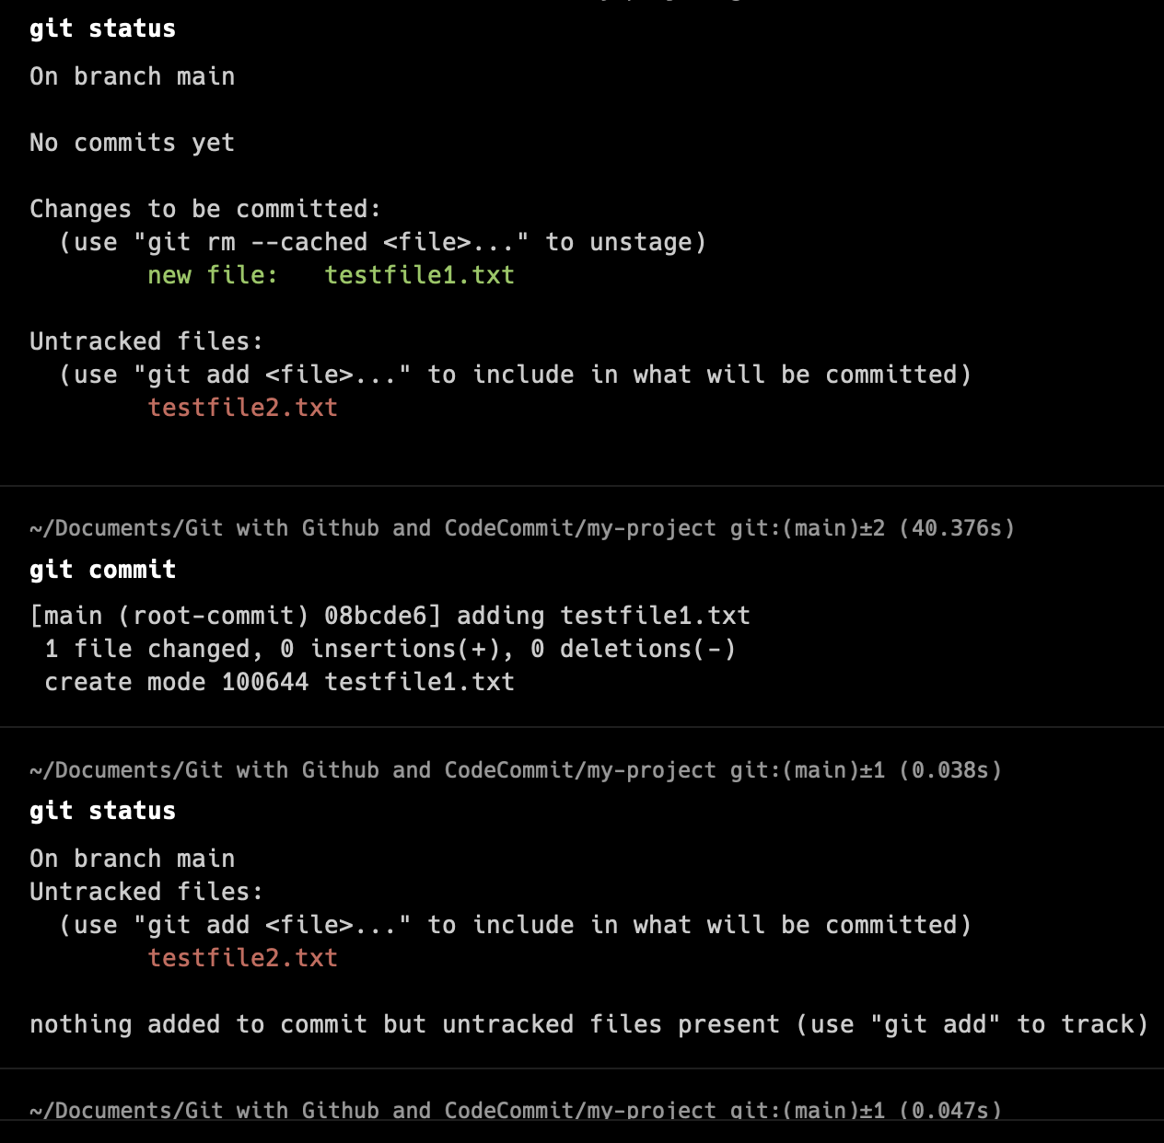
git “commit”
Command : “git commit” / git commit -m”added <file-name>”
Push the code to local repository branch
You can pass a message with commit by adding “-m”. If you don’t pass a message a terminal will open and ask you enter the message for that commit.
The commit message should be descriptive and concise.
Atomic Commits: Each commit should represent a single logical change. Avoid bundling unrelated changes into a single commit.
Only staged changes will be included in the commit
Review staged changes with “git diff --cached” before committing

Slide 9
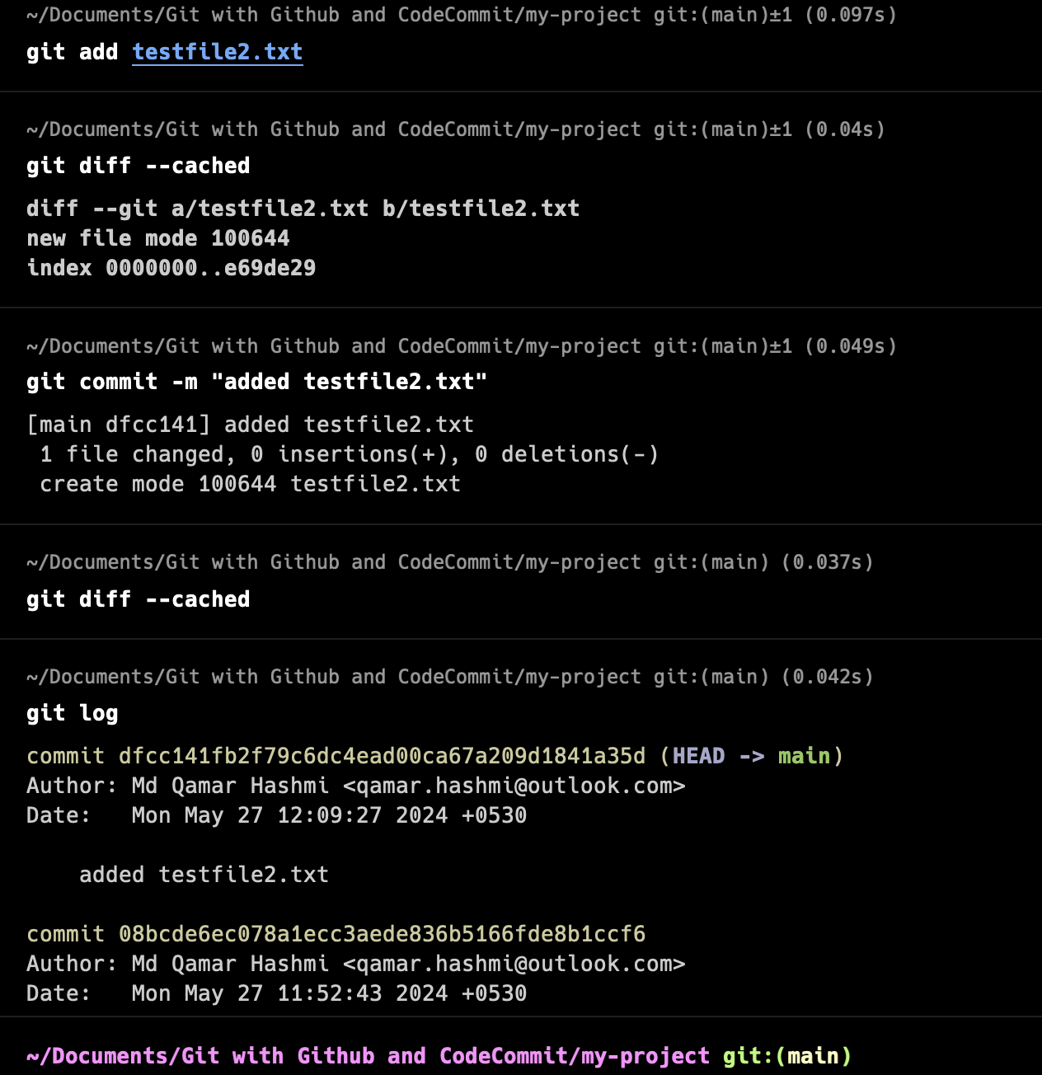
git “log”
Command : git log
“git log” displays a chronological list of commits in the repository, starting from the most recent. Each commit is represented by a unique hash, author, date, and commit message.
You can filter the commit history using various options such as --author, --since, --until, --grep, etc. For example, git log --author="qamar" will show only commits authored by Qamar.
Use options like “--max-count” or “-n” to limit the number of commits displayed. For example, “git log -n 5” will display the last 5 commits.
“git log” can be combined with other Git commands such as grep, diff, show, etc., to perform more advanced operations on the commit history.
By mastering git log, you gain insights into the evolution of your Git repository, enabling you to track changes, understand contributions, and troubleshoot issues effectively.

Slide 10
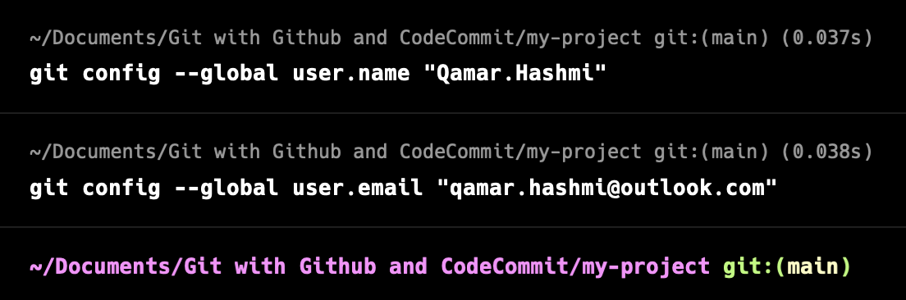
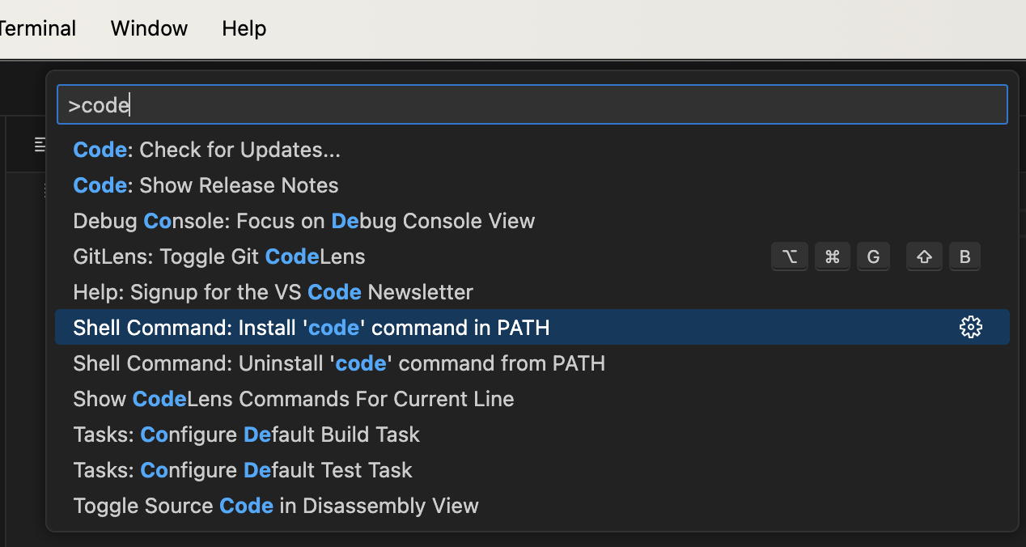
git “config”
Command : “git config <key> <value>
git config is a versatile command used to set or get configuration options for Git.
Git configuration can be set globally for the user or locally for a specific repository. Global configuration affects all repositories on the system, while local configuration is specific to the current repository.
Use git config --global to set global configuration options for the current user. Gets stored in “~/.gitconfig”
Use git config without --global to set local configuration options for the current repository. Gets stored in “.git/config”.
Let’s set user name. Use “user.email” to set email
Command : git config --global user.name "Qamar Hashmi"
Set “VS Code” as your core editor. Open VS code and perform below step
For mac run “command+shift+P”,type “code” and set PATH. For Windows use “control+shift+P”
Command : git config --global core.editor "code --wait"

Slide 11
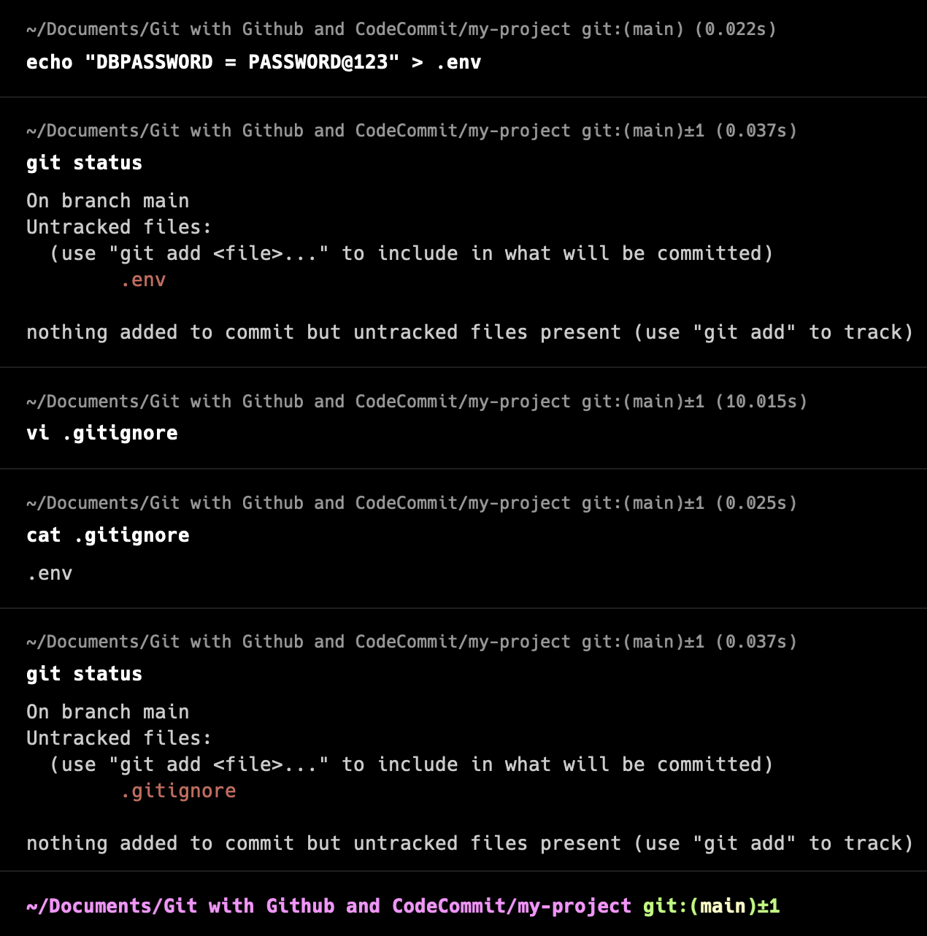
“.gitignore” working
The .gitignore file tells Git which files or patterns it should ignore when tracking changes in a repository. For example, example.txt in the .gitignore file will ignore any file named example.txt.
Ignored files will not be staged or committed unless explicitly added using “git add -f”.
To ignore an entire directory and its contents, specify the directory name in the .gitignore file. For example, /logs/ in the .gitignore file will ignore the logs directory and all files within it.
Use wildcard patterns to ignore files based on their extensions. For example, *.log in the .gitignore file will ignore all files with the .log extension.
You can create a global .gitignore file that applies to all Git repositories on your system. Specify the global .gitignore file's path in your Git configuration using “git config --global core.excludesfile”.
.gitignore generator : https://www.toptal.com/developers/gitignore

Slide 12
Working with Git Branch !
Branching in Git is a powerful feature that allows developers to work on separate lines of development without affecting the main codebase.
The default branch in Git is usually called master or main.
Git branching allows for various workflows, such as feature branching, release branching, and GitFlow.
Regularly merge changes from the main branch into feature branches to keep them up-to-date.
When you create a new branch, Git creates a new pointer that initially points to the same commit as the branch you were on.
Keep branches focused on a single task or feature to simplify review and merging.

Slide 13
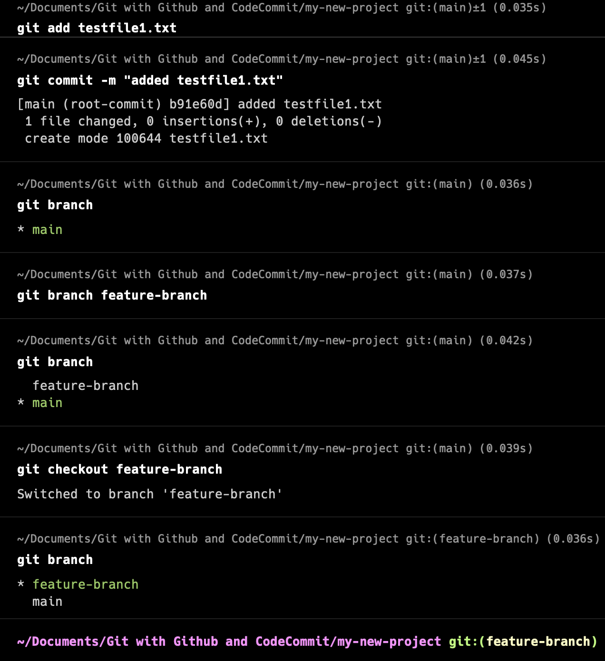
git “branch”
Use the git branch <branch-name> command to create a new branch. For example, git branch feature-branch creates a new branch named feature-branch.
Use the git branch command to list all existing branches in the repository.
Use the git checkout/switch <branch-name> command to switch to a different branch. For example, git checkout feature-branch switches to the feature-branch branch.
Before performing git checkout <branch-name> ref was referring to ref: refs/heads/main
After performing git checkout feature-branch refer is pointing to ref: refs/heads/feature-branch.
Use the git merge <branch-name> command to merge changes from one branch into another. For example, git merge feature-branch merges changes from feature-branch into the current branch.
Use git branch -d <branch-name> command to delete the branch name

Slide 14
Working with git merge
Merge Basics:
Merging is the process of combining changes from one branch into another. It's commonly used to integrate feature branches into the main development branch (e.g., master or main).
Fast-Forward Merge:
If the target branch (e.g., master) has not diverged from the source branch (e.g., feature-branch), Git performs a fast-forward merge. In a fast-forward merge, Git simply moves the target branch pointer to the latest commit of the source branch.
3-Way Merge:
When the branches have diverged, Git performs a 3-way merge. A 3-way merge compares the common ancestor commit of the branches with the latest commits of each branch to reconcile the changes.

Slide 15
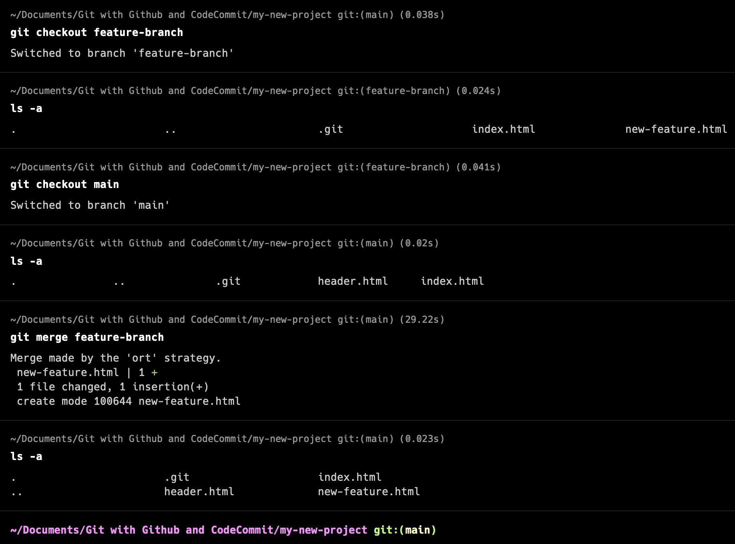
Fast-Forward Merge
Fast-forward merges are common in workflows where feature branches are frequently created and merged back into the main branch, especially when the feature branches have a linear history.
Fast-forward merges are fast and efficient because they do not involve creating new commit objects or resolving conflicts. Git can simply move the branch pointer to the new commit.
Let’s understand with an example shown on the right side.
We have created two branch “main” and “feature-branch” with initially having only “index.html”
Next we added “new-feature.html” in feature-branch and “header.html” in main branch.
Please note, no changes has been made in index.html which was part of initial commit.
Now, we can simply perform a merge from the main branch using below command and there will be no conflicts between the two branches.
Command : git merge feature-branch -m “You_message”

Slide 16
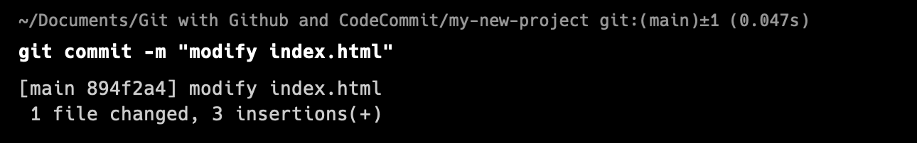
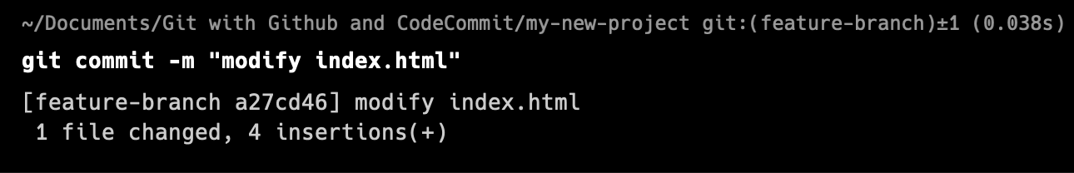
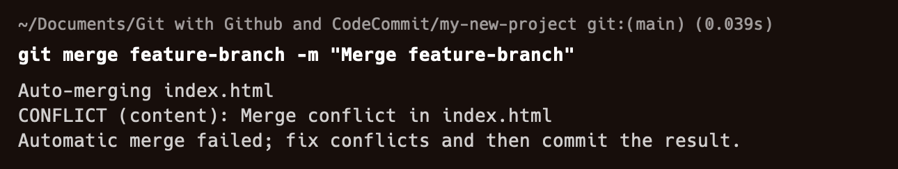
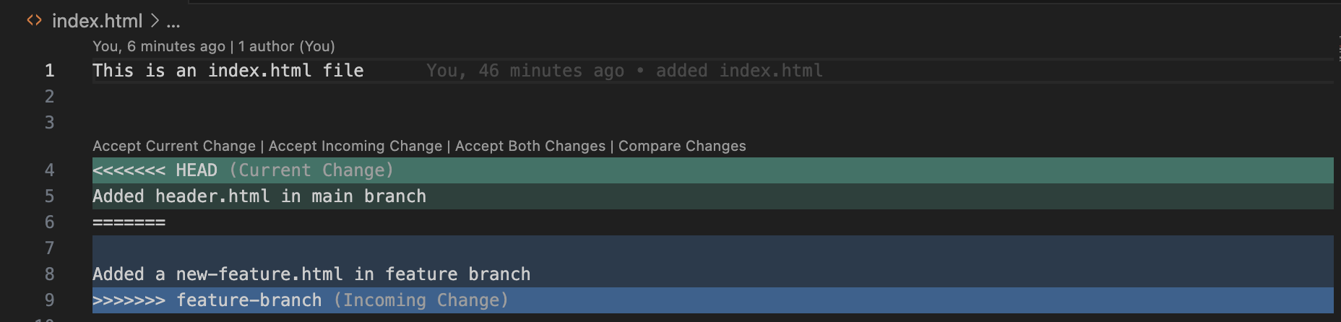
3-Way Merge
A 3-way merge is performed when merging two branches with divergent histories. Git identifies a common ancestor commit and uses it as a reference point to integrate changes from both branches.
In a 3-way merge, Git considers three versions of the code: the common ancestor (base), the current branch being merged into (target), and the branch being merged in (source).
Git automatically integrates changes from both branches by comparing the changes made in the source and target branches relative to the common ancestor. It then applies these changes to create a new merge commit.
If Git encounters conflicting changes between the source and target branches, it stops the merge process and asks the user to resolve the conflicts manually. Conflicts occur when changes made in one branch conflict with changes made in the other branch.
Once all conflicts are resolved, Git creates a new merge commit that incorporates the changes from both branches. This merge commit has two parent commits, representing the branches that were merged.

Slide 17
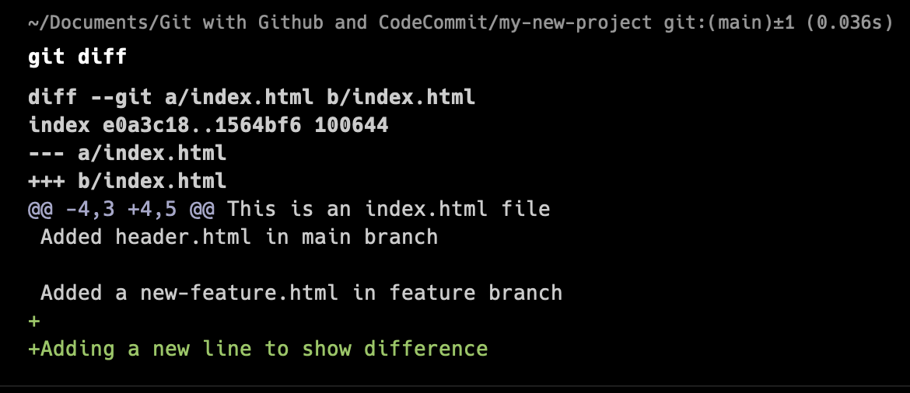
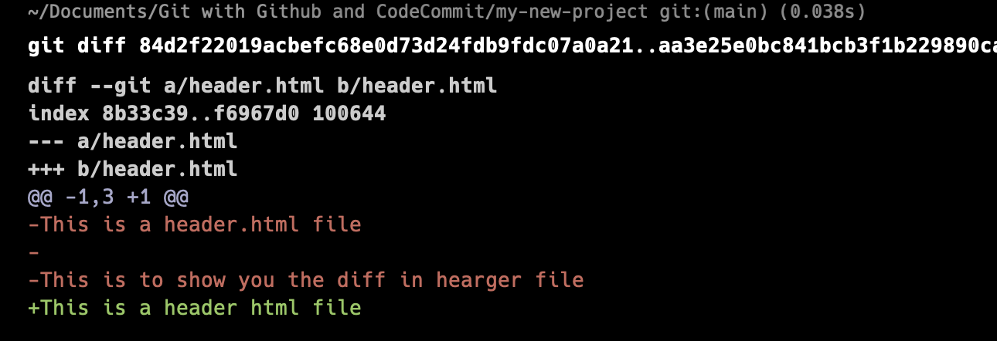
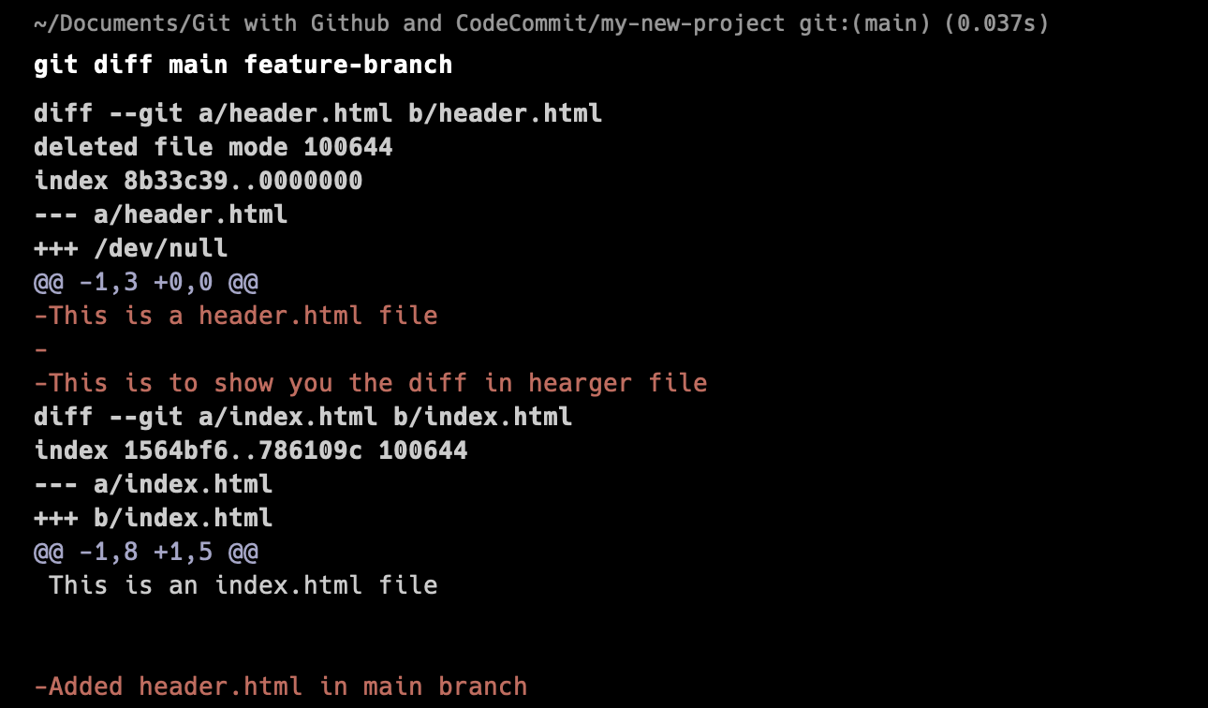
git “diff”
git diff is a Git command used to show changes between commits, branches, or any two arbitrary points in the Git history. It compares the content of files in different commits or branches and displays the differences.
When used without any arguments “git diff”, it compares the working directory (the current state of the files) with the index (the staged changes) and shows the differences.
Adding the --cached flag to git diff (or --staged for older versions of Git) compares the changes that are staged (added using git add) with the last commit. This is useful for reviewing changes before committing.
You can use git diff followed by two commit hashes to compare the content of files between those two commits. For example, “git diff commit1 commit2” will show the differences between commit1 and commit2.

Slide 18
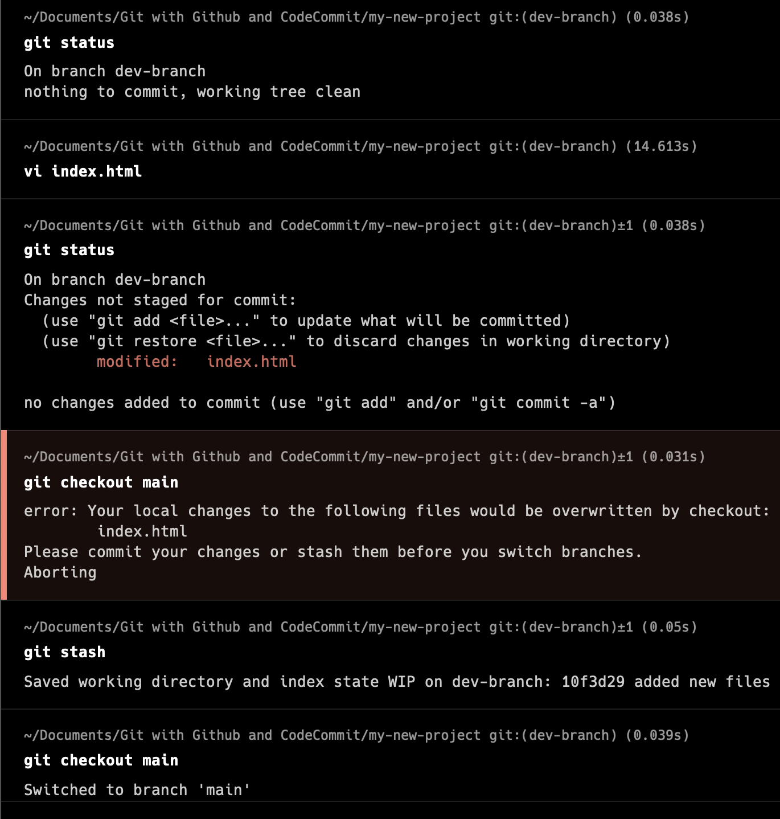
git “stash”
“git stash” is a command in Git that allows you to temporarily store changes that are not ready to be committed. It's useful when you need to switch to another branch or work on a different task without committing your current changes.
“git stash pop” applies the changes from the most recent stash and removes it from the stash stack. This is a convenient way to apply changes and clean up the stash stack in one step.
If you want to remove specific stashes from the stash stack, you can use “git stash drop” followed by the stash identifier. Alternatively, you can clear all stashes at once using “git stash clear”.
You can have multiple stashes in Git. Each stash is assigned a unique identifier (stash@{n}, where n is the index of the stash, starting from 0), allowing you to stash changes multiple times and retrieve them individually.
You can use git stash list to see a list of all stashes in the repository. This command shows the stash ID, the branch from which the stash was created, and a message if provided.
To apply the changes from a stash, you can use “git stash apply”. By default, it applies the changes from the most recent stash, but you can specify a different stash using its identifier.

Slide 19
git “rebase”
Rebase vs. Merge: While merging combines the changes of two branches, rebasing reapplies the commits of one branch onto another. This results in a linear history without merge commits, which can make the project history cleaner and easier to understand.
Similar to merging, rebasing can lead to conflicts when Git tries to apply commits onto a different base. You'll need to resolve these conflicts manually by editing the affected files, marking them as resolved with git add, and continuing the rebase with git rebase --continue.
One should never run rebase command on the main/master branch. It should be only applied to side branches like dev, feature.
Before merging a feature branch into the main branch (e.g., master), it's common practice to rebase the feature branch onto the latest commits from the main branch. This ensures that the feature branch incorporates the latest changes and resolves any conflicts before integration.

Slide 20

What is GitHub ?
GitHub is primarily used for version control, allowing developers to manage and keep track of changes made to their codebase over time.
Projects on GitHub are stored in repositories. Each repository contains all the files and folders associated with a project, along with the version history.
GitHub facilitates collaboration among developers. Multiple contributors can work on the same project simultaneously, making changes, proposing modifications, and reviewing each other's code.
Developers can create branches within a repository to work on new features or bug fixes without affecting the main codebase. Branches can be merged back into the main branch once changes are complete and reviewed.
GitHub integrates with a wide range of third-party services and tools, including continuous integration (CI) systems, project management platforms, and code quality analysis tools, enhancing the development workflow.

Slide 21
Different Ways of Authenticating GitHub
Basic Authentication:
This method involves providing your GitHub username and password directly through the CLI. While simple, this approach is less secure and not recommended for long-term use. However, it may be suitable for quick, one-off operations.
$ git clone https://username@github.com/user/repo.git
Personal Access Tokens:
Personal access tokens are a secure way to authenticate with GitHub via the CLI. You can generate a token with specific permissions (e.g., repo access, user access) and use it instead of your password.
$ git clone https://<username>:<token>@github.com/user/repo.git
SSH Keys:
When the branches have diverged, Git performs a 3-way merge. A 3-way merge compares the common ancestor commit of the branches with the latest commits of each branch to reconcile the changes.
$ git clone git@github.com:user/repo.git
GitHub CLI (gh):
GitHub CLI is an official command-line tool provided by GitHub. It allows you to perform various GitHub-related tasks from the command line, including authentication.
$ gh auth login

Slide 22
git “push”
The primary purpose of git push is to upload local commits to a remote repository, making them accessible to others who have access to that remote repository.
If a branch is specified in the command (e.g., git push origin main), Git will push the commits from that branch to the corresponding branch on the remote repository.
When you use git push without specifying the remote and branch names, Git will attempt to push the current branch to its upstream branch (if it's set up). This is called a "tracking branch."
When you execute git push, Git will prompt you for authentication credentials if necessary, depending on the remote repository's access settings. This could involve entering a username and password or providing an authentication token.
Command : git push <remote> <branch>
Here, <remote> refers to the name of the remote repository (e.g., origin), and <branch> is the name of the branch you want to push changes from.

Slide 23
git “fetch”
The primary purpose of git fetch is to retrieve new commits and updates from a remote repository to your local repository. However, it doesn't integrate these changes into your working branch.
Unlike git pull, which automatically merges fetched changes into your local branch, git fetch only downloads the changes to your local repository. This allows you to review the changes before merging them, providing more control over the process.
git fetch is useful for keeping your local repository synchronized with the remote repository, allowing you to see what work has been done by others without affecting your local branches.
After fetching changes, you can review the updates using commands like git log or git diff and then merge the changes into your local branch using git merge or git rebase.
Command : git fetch <remote>
Here, <remote> refers to the name of the remote repository from which you want to fetch changes (e.g., origin).

Slide 24
git “pull”
git pull is a convenient way to update your local repository with changes from a remote repository. It first performs a git fetch to retrieve new commits and updates from the remote, and then it automatically merges those changes into the current branch.
If you're on a local branch that is tracking a remote branch, you can simply execute git pull without specifying the remote and branch names. Git will automatically fetch changes from the remote branch it's tracking and merge them into your local branch.
Before merging changes with git pull, it's crucial to fetch the latest changes from the remote repository to ensure you're working with up-to-date information.
Command : git pull <remote> <branch>
Here, <remote> refers to the name of the remote repository (e.g., origin), and <branch> is the branch from which you want to pull changes.

Slide 25
git “submodule”

Slide 26

4. Closing
Build confidence around your product or idea by including at least one of the these slides:
Milestones What has been accomplished and what might be left to tackle?
Testimonials Who supports your idea (or doesn’t)?
What’s next? How can the audience get involved or find out more?

Slide 27

Good luck!
We hope you’ll use these tips to go out and deliver a memorable pitch for your product or service!
For more (free) presentation tips relevant to other types of messages, go to heathbrothers.com/presentations
For more about making your ideas stick with others, check out our book!

